Slide 1


Slide 2
Health Insurance Parity for Mental Health and Substance Use Disorder
Michael C. Barnes, JD
Andrea G. Barthwell, MD, DFASAM
Sequel Health Law
Encounter Medical Group
Joseph M. Maschman, JD
Legislative Analysis and Public Policy Association

Slide 3
Faculty Disclosures
Andrea Barthwell, MD, DFASAM: AZZLY – Advisory Board (ongoing); Encounter Medical Group, PC – Employee/Owner (ongoing); Pocket Naloxone – Consultant (ongoing); Wire Health – Advisory Board (ongoing)
Joseph Maschman has no financial relationships to disclose relating to the subject matter of this presentation
Michael Barnes, JD, has no financial relationships to disclose relating to the subject matter of this presentation

Slide 4
Disclosures
The faculty have been informed of their responsibility to disclose to the audience if they will be discussing off-label or investigational use(s) of drugs, products, and/or devices (any use not approved by the US Food and Drug Administration)
Applicable CME staff have no relationships to disclose relating to the subject matter of this activity
This activity has been independently reviewed for balance
This CME activity includes brand names for participant clarity purposes only. No product promotion or recommendation should be inferred

Slide 5
Learning Objectives
List the limitations and restrictions that have historically reduced access to mental health and SUD coverage in health insurance.
Assess the mental health and SUD parity protections that currently exist.
Discuss the key components of LAPPA's model legislation aimed at expanding parity protections at the state level.

Slide 6
Session Preview
Barnes: Federal Efforts to Advance Parity
1996 and 2008 federal parity laws
2010 ACA enactment, 2014 ACA rules take effect
21st Century Cures Act, 2024 regulations, and enforcement
Parity takes all of us
Barthwell: Parity Policy vs Practice
Parity explained
Red flags
Case study
Industry practices and effects
Advocacy resources
Maschman: Model State Legislation
Model state law

Slide 7
Federal Efforts to Advance Parity
Michael C. Barnes, JD
Sequel Health Law

Slide 8
Parity Timeline
MHPAEA
MHPAEA Interim Final Rules
Final Regs - TRICARE, Medicaid MCOs, ABPs, CHIP
Consolidated Appropriations Act
Mental Health Parity Act
CHIP Reauthorization Act
Affordable Care Act
Final Rule
Parity in FEHB
MHPAEA Final Rules
21st Century Cures Act
1996
1999
2008
2016
2021
2024
2009
2010
2013

Slide 9
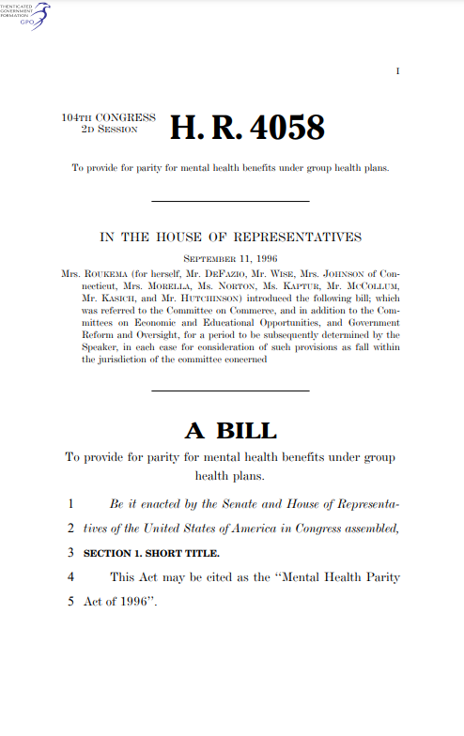
Mental Health Parity and Addiction Equity Act of 2008 (MHPAEA)
Before MHPAEA
2003 Study Findings
Compared to medical/surgical services, MH/SU coverage often involved
More than twice the cost-sharing burden as medical-surgical services
Annual or lifetime service caps that did not apply to medical-surgical services
While the number of employers offering MH/SU coverage greatly increased in the decades preceding MHPAEA, service caps had become more restrictive
Mental Health Parity Act of 1996 prohibited special annual and lifetime dollar limits for mental health benefits, but not for substance use disorder (SUD) care
74 percent of workers with MH/SU coverage under employer-sponsored health plans had an annual outpatient visit limit
64 percent had inpatient day caps
22 percent had higher cost sharing for MH/SU than for med/surg benefits
Barry CL, Huskamp HA, Goldman HH. A political history of federal mental health and addiction insurance parity. Milbank Q. Sep 2010;88(3):404-33.
Barry CL, Gabel JR, Frank RG, Hawkins S, Whitmore HH, Pickreign JD. Design Of Mental Health Benefits: Still Unequal After All These Years. Health Affairs. 2003/09/01 2003;22(5):127-137.
Notes:
On October 3, 2008, President George W. Bush signed the Emergency Economic Stabilization Act of 2008 to bail out financial institutions as a step toward addressing the nation’s financial crisis. As a provision of this legislation, the Paul Wellstone and
Pete Domenici Mental Health Parity and Addiction Equity (MHPAE) Act (P.L. 110-343) was passed into law.

Slide 10
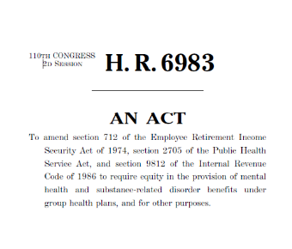
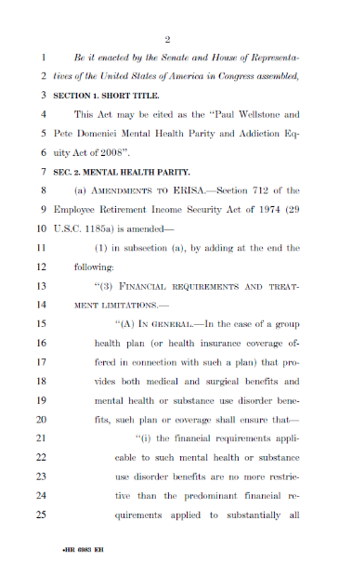
Key MHPAEA Provisions
Types of Treatment Limitations
‘‘(i) the financial requirements applicable to such mental health or substance use disorder benefits are no more restrictive than the predominant financial requirements applied to substantially all medical and surgical benefits covered by the plan…”
‘‘(ii) the treatment limitations applicable to such mental health or substance use disorder benefits are no more restrictive than the predominant treatment limitations applied to substantially all medical and surgical benefits covered by the plan…and there are no separate treatment limitations that are applicable only with respect to mental health or substance use disorder benefits.”
Quantitative
Annual or lifetime caps
Number of days allowed per episode of care
Non-Quantitative
Medical necessity criteria
Preauthorization requirements
Network limitations
Step therapy (“fail-first”) requirements
Notes:
Financial requirements include deductibles, co-payments, coinsurance, or out-of-pocket maximums. They do not include aggregate lifetime or annual dollar limits.

Slide 11
Applicability
Individual markets
Small and large groups
Medicaid (except fee-for-service)
Children’s Health Insurance Plan
NOT self-insured employer plans covering groups of no more than 50 employees
NOT Medicare
NOT retiree-only plans, short-term coverage, and “excepted benefits” coverage
KFF, Mental Health Parity at a Crossroads, Aug. 18, 2022, https://www.kff.org/mental-health/issue-brief/mental-health-parity-at-a-crossroads/.

Slide 12
Regulation – Federal Agency Responsibilities
U.S. Department of Labor, Employee Benefits Security Administration (EBSA) enforces Title I of ERISA, which governs ~2.6 million private employment-based group health plans covering an estimated 136 million people (July 2023)
CMS enforces regulated plans covered under Title XXVII of the PHS Act, including ~91,000 non-Federal governmental group health plans and 67 issuers in two States where it is the direct enforcer of MHPAEA (July 2023)
Treasury covers a small number of plans associated with religious organizations

Slide 13
Perspective
Actions | EBSA | CMS | Total
Initial Letters | 17 | 22 | 39
Insufficiency Letters | 45 | 10 | 55
Initial Determination Letters | 13 | 19 | 32
Final Non-Compliance Determinations | 0 | 3 | 3
Total | 75 | 54 | 129
EBSA – 75 actions across 2.6 million plans
CMS – 54 actions across 91,000 plans and 67 issuers
EBSA: “Budget constraints have left the agency with an enforcement capacity of roughly one investigator for every 13,900 plans it regulates” and, from 2013 to 2021, “EBSA’s annual appropriations have declined when
accounting for inflation…EBSA also has experienced a decline in staffing over this period.” It has “been partially reversed due to supplemental funding for CAA implementation,” which expired December 31, 2024.
CMS: The agency “relies on its approximately 15 investigators to review plans and issuers for compliance with MHPAEA and other provisions of title XXVII of the PHS Act.”
2024 MHPAEA Report to Congress, January 2025. https://www.dol.gov/sites/dolgov/files/ebsa/laws-and-regulations/laws/mental-health-parity/report-to-congress-2024.pdf.
Notes:
During the 12-month reporting period, EBSA issued:
17 initial letters requesting comparative analyses for 22 NQTLs
45 insufficiency letters covering over 40 NQTLs
13 initial determination letters for violation of MHPAEA requirements for 21 NQTLs
During its 11-month reporting period, CMS issued
22 initial letters requesting comparative analyses for 22 NQTLs
10 insufficiency letters covering 10 NQTLs
19 initial determination letters for violation of MHPAEA requirements for 19 NQTLs
3 final determinations of noncompliance for 3 NQTLs
Source: 2024 MHPAEA Report to Congress, January 2025

Slide 14
Summary
Progress
Parity compliance is improving
Coverage of and access to behavioral health services is increasing
States can play a key role in ensuring MHPAEA compliance
DOL’s recent enforcement
EBSA efforts have improved access to MH/SUD benefits for 7.6 million participants in over 72,000 plans
Challenges
Compliance remains a challenge
NQTL analysis and documentation remain a challenge for plans/issuers
Compliance monitoring and assistance is complex
Requires highly knowledgeable staff
Time-consuming

Slide 15
Advocacy Opportunities
Federal government is not adequately ensuring compliance
States, as the traditional regulators of insurance, have a key role to play
Employers, including state and local governments, also have an important role to play by ensuring that their plans meet MHPAEA
Associations, providers, community groups, and others can continue to raise awareness and advocate for steps to ensure compliance

Slide 16
Thank You
Please attend the Rx Summit closing plenary: Recovery Friendly Workplaces Thursday, 8:30-9:30 a.m.

Slide 17
Parity Policy vs Practice
Andrea G. Barthwell, MD, DFASAM
Encounter Medical Group

Slide 18
Parity Policy
Limits on MH/SUD benefits must be no more restrictive than those applied to med/surg, and
No separate treatment limits applied only to MH/SUD
SAMHSA: The Essential Aspects of Parity, A Training Tool For Policymakers. Publication No. PEP21-05-00-001, 2021.

Slide 19
Comparable, No More Stringent Coverage
Financial (such as copays, deductibles, or out-of-pocket maximums)
Dollar limits (annual or lifetime)
Quantitative (QTLs, such as number of days, outpatient visits, or lab services)
Non-quantitative (NQTLs, such as provider qualifications or documentation requirements)
USDOL, EBSA: Understanding Your Mental Health and Substance Use Disorder Benefits. https://www.dol.gov/agencies/ebsa/about-ebsa/our-activities/resource-center/publications/understanding-your-mental-health-and-substance-use-disorder-benefits. Accessed 2/16/2025.

Slide 20
Compare by Classification
Benefit Classification | MH/SUD | Medical/Surgical
Inpatient (In-network, out-of-network) | Withdrawal management | Appendectomy
Outpatient (In-network, out-of-network) | Office-based opioid treatment visit | Primary care visit
Emergency | ED for overdose | ED for heart attack
Prescription drug | Long-acting injectable for OUD | Long-acting injectable for high LDL cholesterol
USDOL, EBSA: Understanding Your Mental Health and Substance Use Disorder Benefits. https://www.dol.gov/agencies/ebsa/about-ebsa/our-activities/resource-center/publications/understanding-your-mental-health-and-substance-use-disorder-benefits. Accessed 2/16/2025.

Slide 21
Red Flags
Approving only a few days of benefits at a time
Narrow provider network
Repeat prior-authorizations
Denial for not completing previous treatment
Must update treatment plan periodically
Quantitative limits on therapeutic drug testing
Frequent below-market/unsustainable payments for provider services
USDOL, EBSA: Understanding Your Mental Health and Substance Use Disorder Benefits. https://www.dol.gov/agencies/ebsa/about-ebsa/our-activities/resource-center/publications/understanding-your-mental-health-and-substance-use-disorder-benefits. Accessed 2/16/2025.

Slide 22
Onerous Documentation Requirements
Full medical record
Copies of bills sent to patient
Accounting of payments received from patient
Billing and collection policy
Signed Assignment of Benefits form
List of all licensed employees, including credentials
Proof of program licensure
Proof of lab’s certification or waiver
The name of the lab’s equipment manufacturer
Client Handbook

Slide 23
Case Study
Non-payment or low payment
Insurer’s payment data system, a “race-to-zero” self-referencing database
Insurer’s expert witness
Psychosocial treatment not evidence based
SUD therapy could only be provided by masters- or doctorate-level therapists
Billing for services of state-authorized “substance abuse counselors” was fraud
Entire medical record required to test for more than five substances
Appeal required to test for more than eight substances

Slide 24
“Race-to-Zero” Self-Referencing Database
“Outpatient review program” uses a pricing database to calculate out-of-network provider payment rates.
Insurer pays the lesser of the provider’s charge or the “usual and customary” value drawn from the database.
When the lower payment is fed back into the database, the figure decreases the “usual and customary” value.

Slide 25
Crosswalking
Valuing a service by looking to a similar service (typically using Medicare codes and rates)
Medicare does not cover most SUD services
Insurers crosswalk to lower-cost services or lower levels of care
Differences between RTF and SNF
Services
Patients
Risks of harm (to self and others)
Resources needed
Staffing

Slide 26
Credentialing Requirements
In-network residential | Out-of-network residential treatment | Out-of-network residential withdrawal management
Accredited | Accredited | Accredited
Accepts in-network rates | Provider on duty and active day and evening | Nurse onsite 24/7
 | Physician medical director | Physician immediately available

Slide 27
Other Industry Practices and Effects
“Single case” or “global” agreements
Industry-written “guidelines”
Skirting ERISA protections (low payment vs non-payment)
Pricing and payment contractors have no fiduciary duties to plan participants
Cost-containment companies’ fees are not disclosed on EOB or in plan documents

Slide 28
Example → Cost Containment Contractor Drives up Cost of Healthcare to the Detriment of Plan Members and Plan Sponsors
Reprinted with permission from Arnall Golden Gregory LLP.

Slide 29
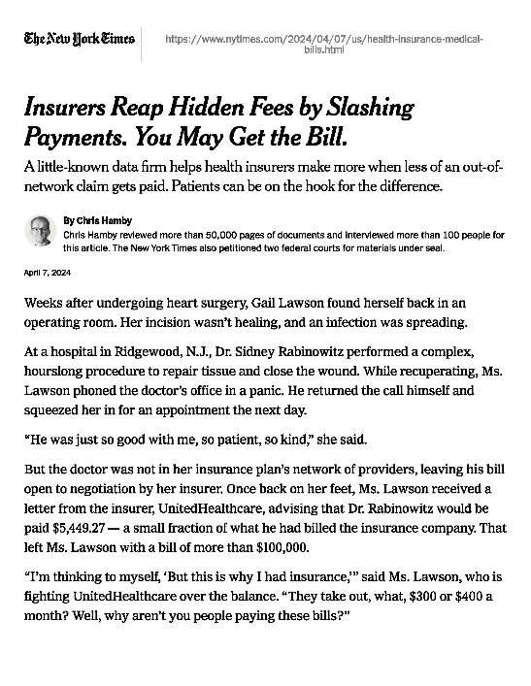
NYT Reporting
April 7, 2024
May 1, 2024
“Insurers Reap Hidden Fees by Slashing Payments. You May Get the Bill”
“Health Insurers’ Lucrative, Little-Known Alliance: 5 Takeways”
“In Battle Over Health Care Costs, Private Equity Plays Both Sides”
“Collusion in Health Care Pricing? Regulators Are Asked to Investigate”

Slide 30
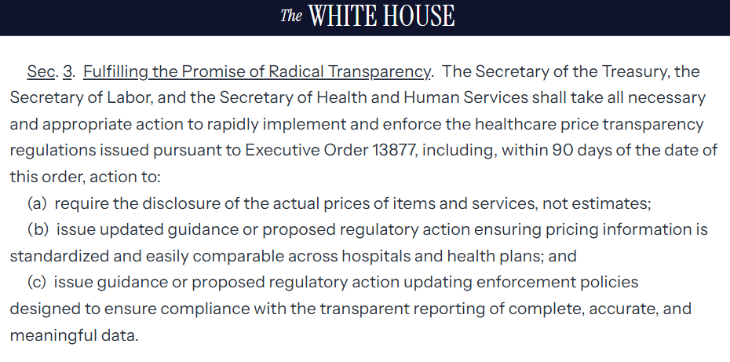
Executive Order February 25, 2025

Slide 31
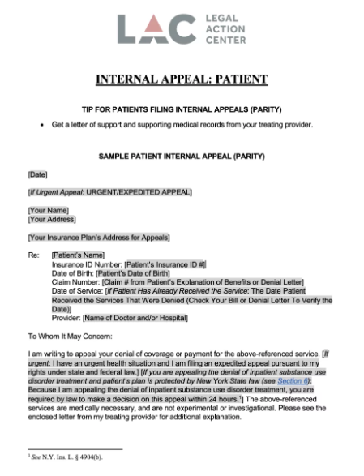
Advocacy Resources
Federal parity resources (DOL)
https://www.dol.gov/agencies/ebsa/laws-and-regulations/laws/mental-health-and-substance-use-disorder-parity
Sample forms for challenging MH/SUD coverage denials (Legal Action Center)
https://www.lac.org/resource/sample-forms-for-challenging-denied-mh-sud-claims
Sample state and federal complaints (Legal Action Center)
https://www.lac.org/resource/sample-forms-for-challenging-denied-mh-sud-claims
List of state insurance commissioners (NAIC)
https://content.naic.org/state-insurance-departments

Slide 32
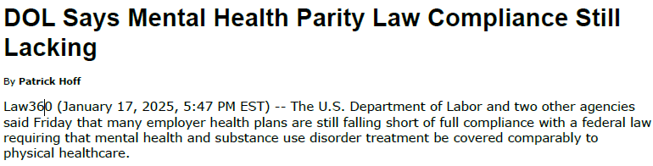
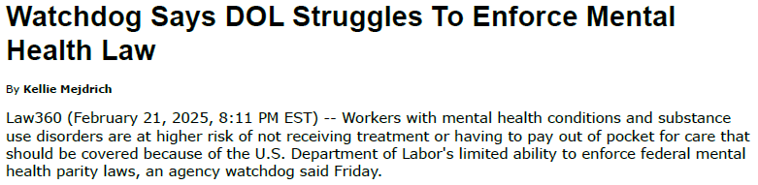
Inform Patients and Providers
Federal and state parity protections and resources
Health insurer internal and external appeals and sample forms
Report non-compliance to the state insurance commissioner (copy the insurance company CEO and medical director)
Educate HR on harms of cost containment programs so plan sponsors decline them
Consider consulting an attorney with experience in parity enforcement

Slide 33
Support Enhanced State Parity Legislation
Ask your state legislators to introduce or vote in favor
Ask your governor to propose, prioritize, and sign
Coordinate coalition letters if possible

Slide 34
Model State Legislation
Joe Maschman
Legislative Attorney
Legislative Analysis and Public Policy Association (LAPPA)
jmaschman@thelappa.org

Slide 35



About LAPPA
https://legislativeanalysis.org/
501(c)(3) nonprofit organization
Drafts model legislation and conducts legal and legislative research and analysis on law and policy in the areas of public safety and health, substance use disorders, and the criminal justice system
Office of National Drug Control Policy’s (ONDCP’s) Model Acts Program Grant recipient
https://legislativeanalysis.org/

Slide 36


Slide 37
Role of States in Parity Enforcement
State governments are the primary regulators of health insurance
MHPAEA (as amended) sets parity standards and requires insurers to provide comparative analysis reports to federal departments (DOL, HHS, Treasury) and state officials upon request
Noncompliance with MHPAEA is a challenge: in 2021, the federal departments found that none of the health insurer reports provided sufficient information to meet requirements
Many state insurance commissioners have the power to investigate compliance, but these powers are often discretionary. Enforcement can depend on individual state officials who prioritize parity

Slide 38
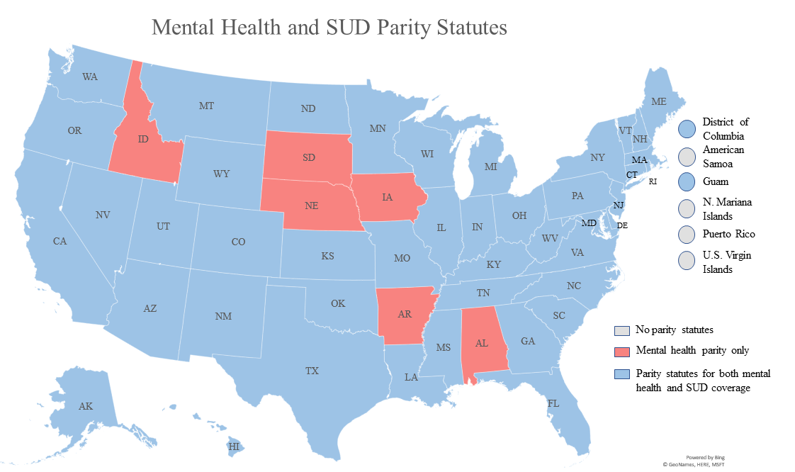
Parity in the States
All 50 states, the District of Columbia, and Guam have a parity statute of some kind
Six states (Alabama, Arkansas, Idaho, Iowa, Nebraska, and South Dakota) only require parity for mental health coverage

Slide 39
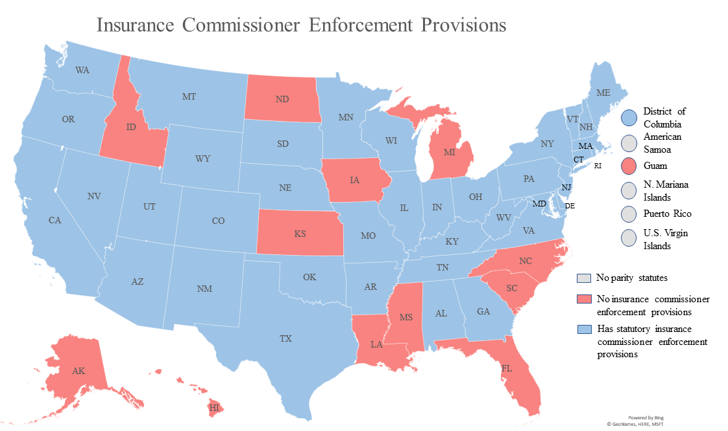
Parity in the States
38 states, the District of Columbia, and Guam require a state authority, typically the state insurance commissioner, to enact regulations, submit reports, take enforcement actions, or otherwise enforce the statutory parity requirements on health insurers.

Slide 40
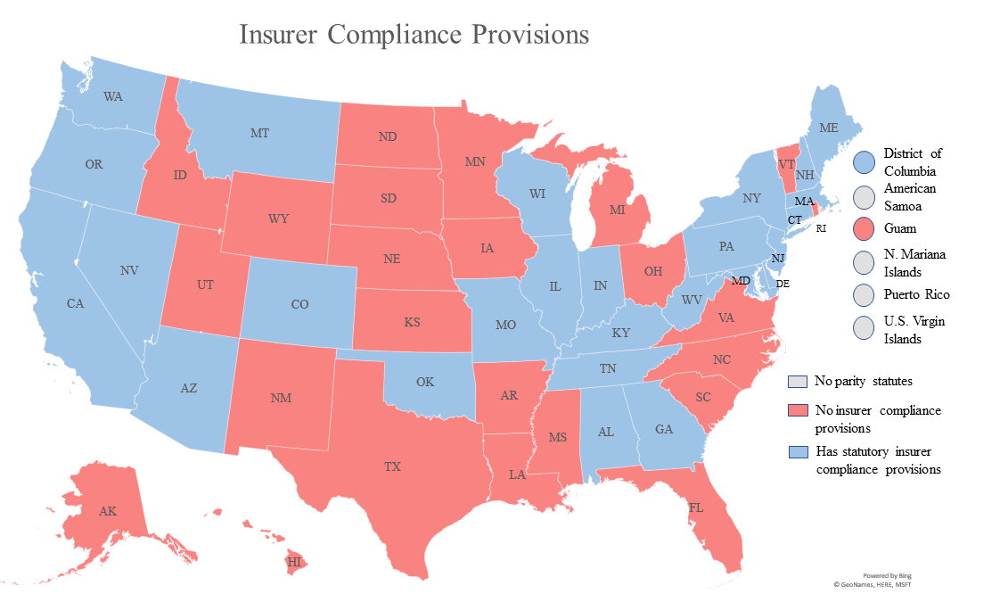
Parity in the States
26 states and DC require health insurance companies to demonstrate compliance with state or federal parity requirements, typically through annual reports
24 states and Guam do not

Slide 41
Objectives of the Model Act
Incorporate MHPAEA-style parity requirements in state law
Direct health insurers to provide detailed analysis of their treatment limitations to prove parity compliance
Establish mandatory enforcement actions for state insurance commissioners

Slide 42
Parity Mandate
Financial requirements, QTLs, and NQTLs for mental health/SUD benefits are no more restrictive than for medical/surgical benefits
New data requirements for NQTLs to prove compliance
No prior authorization or step therapy for mental health/SUD prescription drugs
Parity for annual and aggregate lifetime limits
No exclusion for services that could be covered by entitlement program

Slide 43
Health Insurer Reporting Requirements
Annual reports containing detailed information justifying NQTLs for mental health/SUD benefits
Signed certification that CEO and chief medical officer have reviewed administrative procedures for compliance with parity laws
Specific requirements for NQTL comparative analyses based on federal regulations: detail which information is needed places burden of persuasion on insurance companies to prove compliance

Slide 44
Insurance Commissioner Enforcement
Commissioners “shall implement and enforce…”; not discretionary
Require insurers to submit comparative analyses
Maintain a consumer complaint log and respond to complaints of possible parity violations
Perform periodic market conduct examinations of health insurers
Impose monetary penalties on insurers who fail to submit required data

Slide 45
Insurance Commissioner Enforcement, cont.
Require insurers to remedy denials of care caused by violations of parity law by
Changing insurance plans’ treatment limitations
Reprocessing and paying denied claims
Informing plan members of parity violations
Requiring additional data submissions or monitoring to prove compliance
Submit annual legislative report on the year’s enforcement actions
Maintain public website with consumer parity information, including step-by-step guide for filing complaints

Slide 46
Miscellaneous
Parity Advancement Fund: all monetary penalties collected from parity violations are deposited into a fund that supports consumer parity education campaigns, assistance programs, advocacy, and other pro-consumer implementation and enforcement initiatives

Slide 47
Q&A
Thank you for participating in our session.

